Slide 1
Integrated information on risks as a key to reduce disasters: example of Guadeloupe Archipelago in the Eastern Caribbean
Presented by
Dr. Myriam LUBINO-BISSAINTE
MIRAI Sustainable Development Consultancy

Slide 2
I want to present here some case studies involving several actors of our community, civil societies, corporate sectors, who are aware that preventive actions through information, which are the link between knowledge and practice, can reduce significantly the impact of the seismic risk on vulnerable communities.

Slide 3
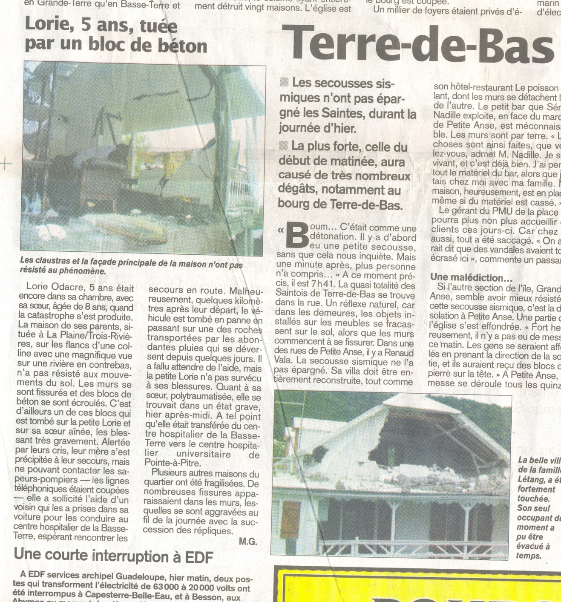
In France Antilles,
local newspaper, 22nov04

Slide 4
But several years before that day!!!!!
We were talking about Prevention and Preparation, at each level of our society!

Slide 5
Since that day!!!!!!!
Other national actions have been conducted:
*Seminar
*TV spots

Slide 6
THE OBJECTIVES
The recent seismic events of “Les Saintes Island” had showed the need to improve the effectiveness of the actors and devices for prevention and management of crisis. The seismic plan of prevention presented on December 8, 2004 by the Minister for the MEDD (Ministry of Ecology and Sustainable Development) is declined along 3 axes:
To look further into knowledge, to better inform
To improve the taking into account of the risks in the construction industries
To concert, cooperate, communicate

Slide 7
So the DDE proposes a seminar of one day work to its elected and institutional local partners, to improve knowledge and the possibilities of reduction of the impacts, and to federate preventive actions included/understood well, better shared by the various components of the civil society:
To present the state of knowledge of the local seismic risk
To answer the legitimate interrogations that this series of events made emerge
To release from the collegial tracks of progress between the various services to improve the existing devices of prevention, and to consider common actions.

Slide 8
The second national action since this earthquake: TV Spots (on RFO TV)
BROACHED TOPICS
The phenomenon: knowledge and monitoring
To inform itself on the phenomenon
Installation, construction and regulation
To prepare, prepare its “environment”
During the earthquake
After the earthquake and the management of the crisis.

Slide 9
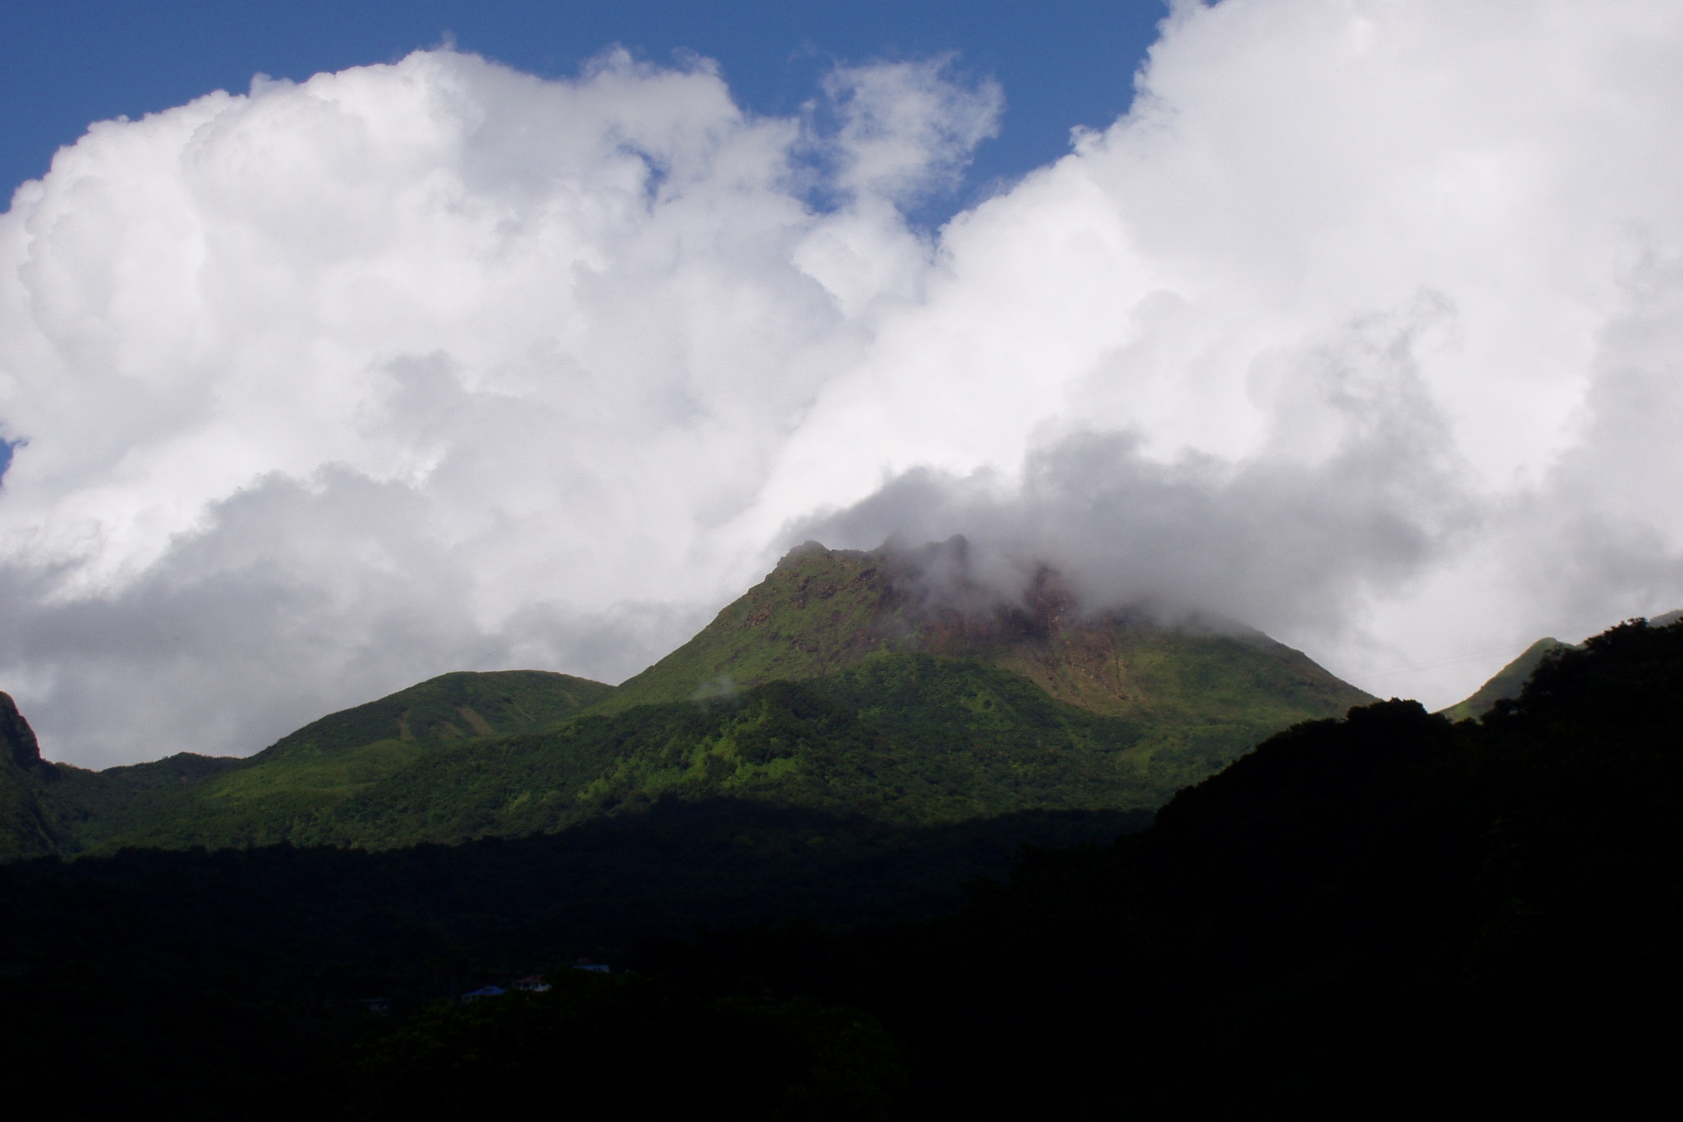
Prevention and Preparation at each level of the society will facilitate
Emergency management and reduce disasters
In our vulnerable countries.
I would like to thank AKUT and The BOSPHORUS UNIVERSITY (Istanbul, Turkey) who give me the opportunity
to present my works
during this important Symposium
Dr. LUBINO-BISSAINTE Myriam

